Slide 1
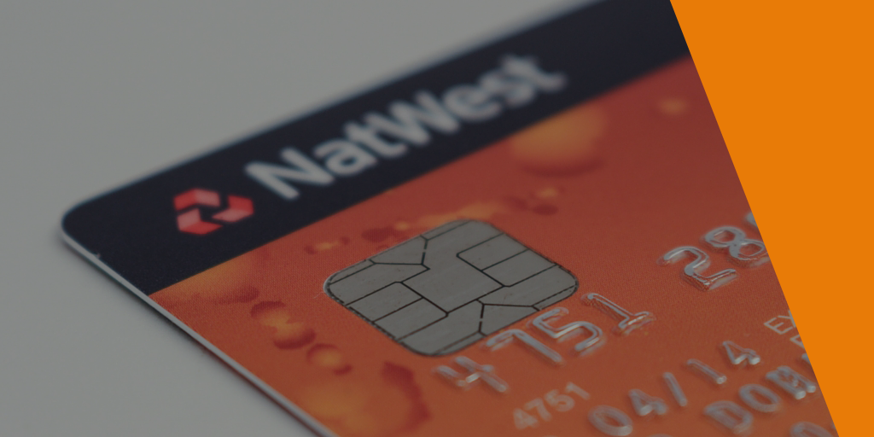
Credit Card Fraud Detection Approach Using Machine Learning
NBQSA Screening Presentation
Bachelor of Science Special (Hons) in Information Technology Specialized in Software Engineering

Slide 2
MEMBER DETAILS
Student Name | Student No.
T.M.G.A.B. Thennakoon | IT15046512
H.G.S. Premadasa | IT15142610
C.B.P. Lochana | IT15111784
M.D.S. Mihiranga | IT15004550
Supervisor : Mr. Nuwan Kuruwitaarachchi
Co-Supervisor : Mr. Lakmal Rupasinghe

Slide 3
INTRODUCTION
Credit card fraud is a wrongful or criminal deception aimed to bring financial or personal gain.
Notes:
In simple terms, Credit Card Fraud is defined as when an individual uses another individual’s credit card for personal reasons while the owner of the card and the card issuer are not aware of the fact that the card is being used.
With rapid development of electronic commerce the number of transactions by credit cards are increasing rapidly, therefore cases of transaction fraud are also increasing.

Slide 4
Fraudulent transactions can occur in various ways and can be put into different categories.

Slide 5
Credit card fraud
Card Present
Card Not Present

Slide 6
Fraud Types
Bankruptcy
Theft/counterfeit
Application
Behavioral

Slide 7
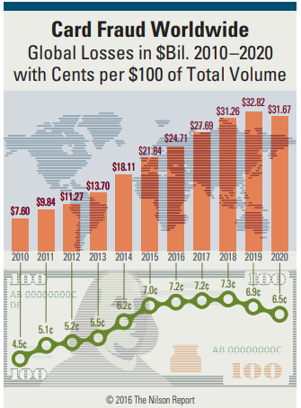
RESEARCH PROBLEM
According to the Nilson Report in October 2016, more than $31 trillion were generated worldwide by online payment systems in 2015, increasing 7.3% than 2014.
Worldwide losses from credit card fraud rose to $21 billion in 2015, and will possibly reach $31 billion by 2020.

Slide 8
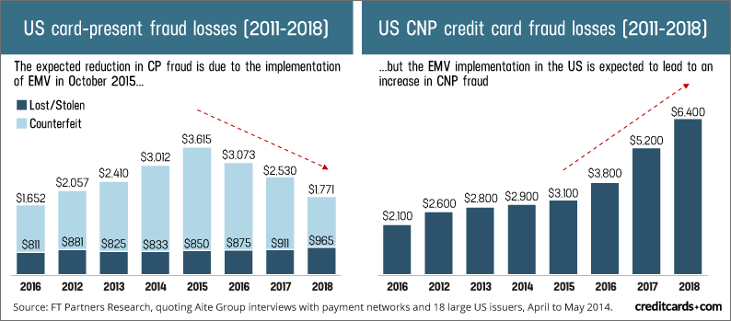
Credit card fraud statistics

Slide 9
MAIN OBJECTIVES
Identifying fraud categories and their patterns.
Selecting the most suitable machine learning algorithms that best fit data.
Train a machine learning model with the highest accuracy and efficiency.
Implementing a fraud detection system.

Slide 10
METHODOLOGY

Slide 11
Data collection and preparation
Date and Time | Date and Time of the transaction
Amount | Transaction amount
Merchant Name | Merchant name responsible for the transaction
Merchant City | City of the merchant
Merchant Country | Country of the merchant
Card Number | Credit card number of the customer
I039_RSP_CD | ISO Response code for transaction
Status | Approved or not approved status of the transaction
Merchant Category Code | Category code of the merchant
Location | Location of the card present transaction
Selected features from the set of data.

Slide 12
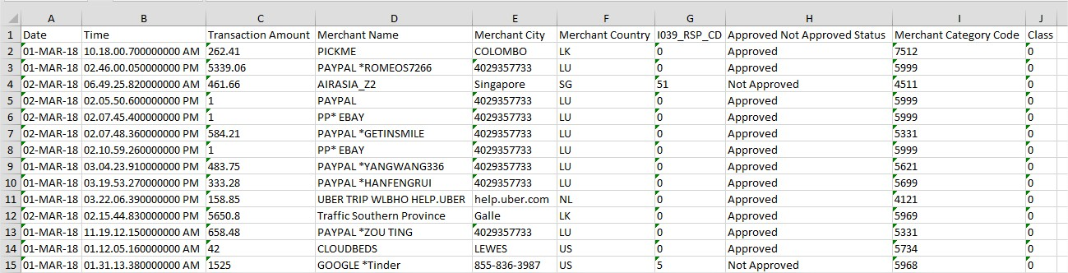

Slide 13
Identifying fraud categories and their patterns.
Bankruptcy fraud (CNP & Card Present)
When ISO response code receive as not sufficient funds (51).
Application fraud
When applications come from a same individual with the same details.
When applications come from different individuals with similar details.

Slide 14
Theft/Counterfeit fraud (Card Present)
When too many transactions occur in card present transactions from the same card within a short period of time.
When the location change without informing by the customer in card present transactions.
When the location changes within a short period.
When ISO response code receive pickup card (41).

Slide 15
Behavioral fraud (CNP)
When transaction amount is greater than $100.
When large purchase after a smaller one.
When merchant belongs to risky category.
When the merchant name is unidentified or banned.
When too many transactions occur in card present transactions from the same card within a short period of time.
When ISO response code receive as too many tries for CVV (N7).

Slide 16
Selecting most suitable machine learning algorithms
Support Vector Machine.
Logistic Regression.
K-means.
KNN.
Naive Bayes.
Decision Tree.
Random Forests.
Deep Learning.

Slide 17
Model training
Use the selected best fitting algorithms.
Train the model using Google cloud ML engine.
Retrain the model with the new transactions for identifying new fraud patterns.
Notes:
Instant access to supercomputers, Train multiple models in parallel, Hyperparameter optimization

Slide 18
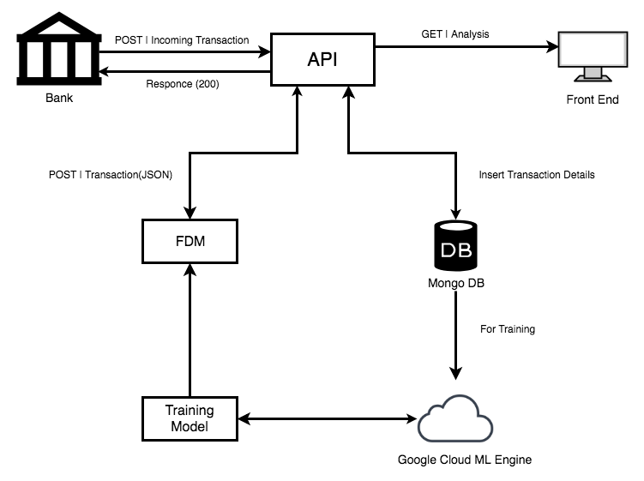
PROPOSED SOLUTION
Notes:
Cloud ML versioning

Slide 19





Technologies Used

Slide 20
UNIQUENESS
Most of the detection systems have been implemented to plug in between the payment gateway and the e-commerce website. Our system is designed to deploy directly into banks.
Can get the summarized reports of already existing transaction logs by uploading a .csv file of the previous transactions.
Efficient model training process by using the Google cloud ML engine.
Retraining the model to adapt the model to new fraud patterns.

Slide 21


Feature | SAS Fraud management | Simility | Riskified | Fraudhunt | FraudLabs | Our System
Detecting card present frauds
Detecting card not present frauds
Can apply directly to bank systems
Ability to retrain for new transactions
Can get the summarized reports of already existing transaction logs
Alert management

Slide 22
UNIQUENESS
Most of the detection systems have been implemented to plug in between the payment gateway and the e-commerce website. Our system is designed to deploy directly into banks.
Can get the summarized reports of already existing transaction logs by uploading a .csv file of the previous transactions.
Efficient model training process by using the Google cloud ML engine.
Retraining the model to adapt the model to new fraud patterns.

Slide 23
MARKET VALUE
According to Financial Fraud Detection Software market report, The Financial Fraud Detection Software market is valued at hundreds of million dollars in 2017 and is expected to grow by millions by the end of 2025.
Growing at a considerable amount of compound annual growth rate between 2018 and 2025.

Slide 24
THANK YOU

